Slide 1
Convolutional Neural Network
HeonHyung Lee,
May 28, 2019

Slide 2
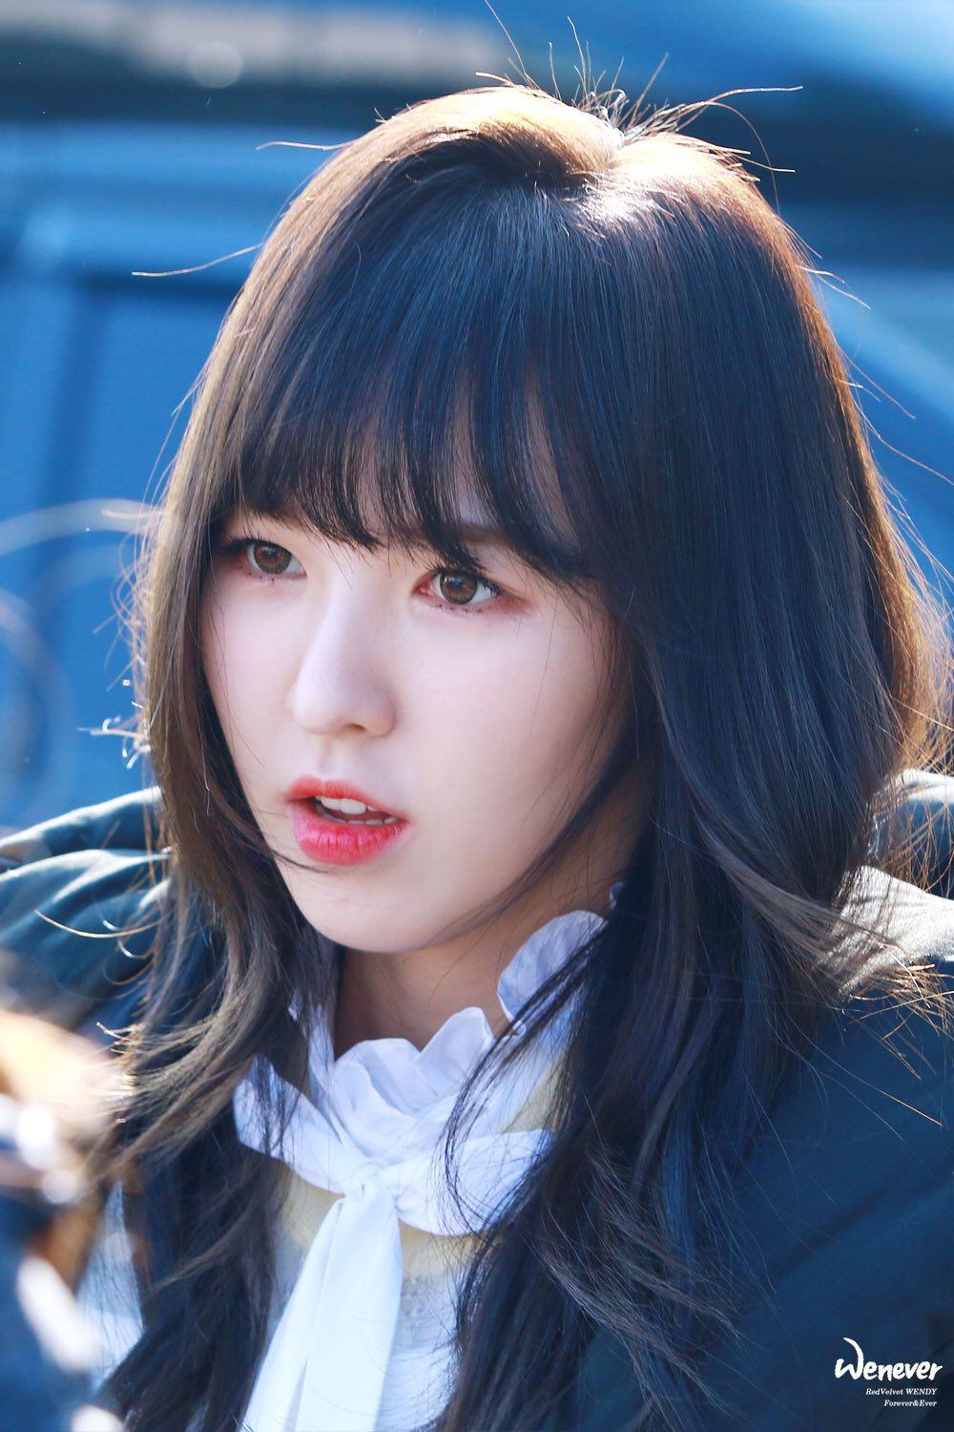
Convolutional Layer
Extarct features from Input data.
Convolutional
Layer
Feature map
Wendy : 95 %
Irene : 3%
Yeri : 1.5 %
Seulki : 0.3%
Joy : 0.2%
Neural
Network
Result of classification

Slide 3
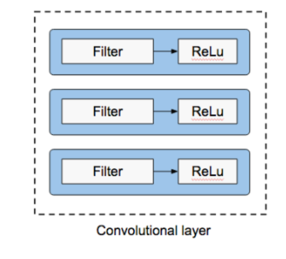
Cont’d
They have Filter and Activation Function.
Filter : Extract features.
Activation : make the value of extracted features an non-linear value, function ReLu used mostly.

Slide 4
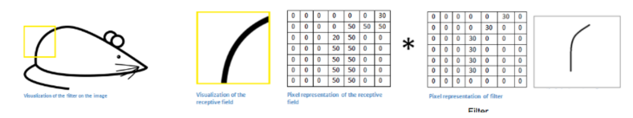
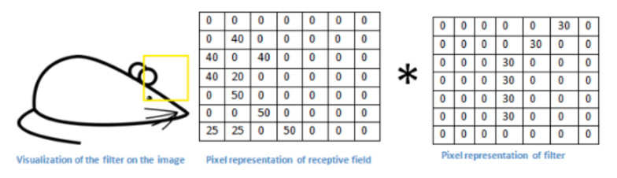
Filter
If an input data and the filter has similar value position, then the result value is high. 50*30+20*30+50*30…
If not, converge to zero.

Slide 5
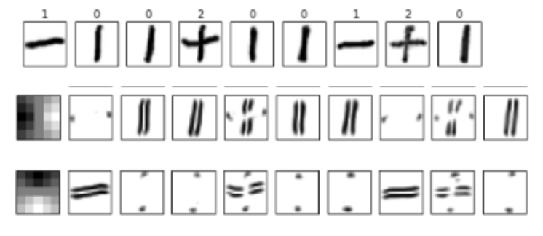
Multiple Filter
The first box of second row
and third row are filters.
They are vertical and horizontal filters respectively.
By combining multiple filter, we could find which pattern the input image has.

Slide 6
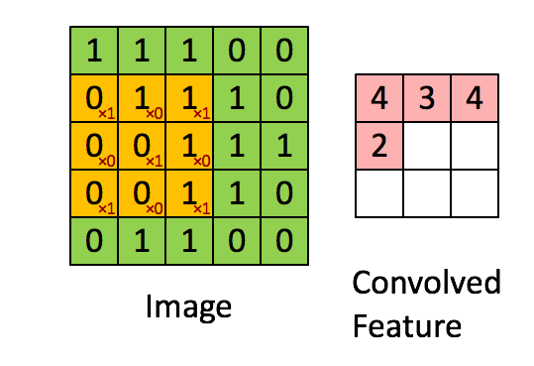
Stride
When we apply a filter over a patch. We have to decide how many cell we ignore after processing each cell.
That is Stride. On the right, Stride is 1.
But Applying filter and too big
stride make the Feature map shrink.
so we use padding.

Slide 7
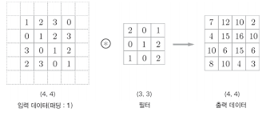
Padding
If the ouput size become smaller after processing filter layer,
it may occur loss of original feature. so we bind the input data with zeros.
And it prevent overfitting
(overfitting means that
Since The network too focus on
Train data, data can’t classify
Other data.) by insert zeros
That have no meaning.

Slide 8
CNN make the filters automatically

Slide 9
Activation Function
After processing filter layer, we apply activation function to
make the output value a non-linear value. Since we need just yes or no.
Sigmoid : it doesn’t work well if the network is going deeper. Since it has problem of back propagation.(Gradient Vanishing)
So we use ReLu.

Slide 10
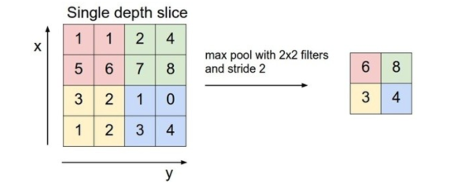
Pooling
if we get features
to a certain extent,
We don’t need all feature to classify an object actually,
Like that in real world we can recognize an orange with
Low-resolution image.
So we use pooling. It makes computational budget less.
And it also prevent overfitting by making loss of some data.

Slide 11
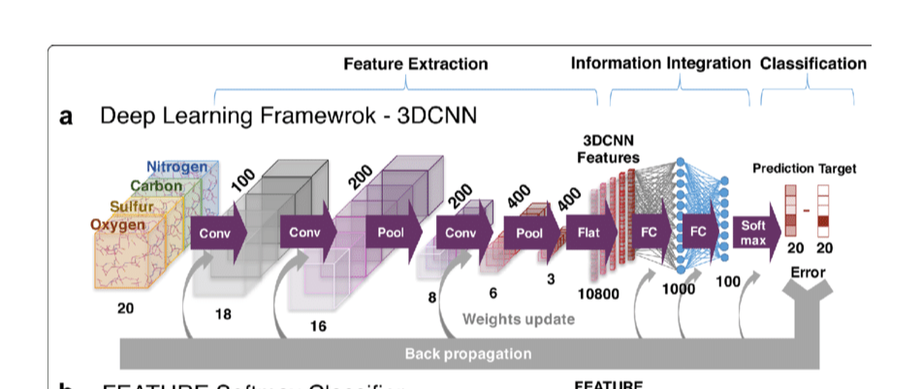
Fully connected layer
After we get feature using convolutional layers,
we use Fully connected layer to classify.

Slide 12
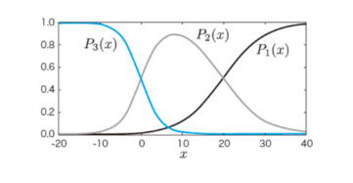
Softmax
Softmax function has several criteria of probability to classify unlike sigmoid and ReLu.
For instance) P1 : Irene, P2: Yeri, P3: Wendy
when x= -10, the P3(x) is the highest value,
so the result will be classified
As Wendy.

Slide 13
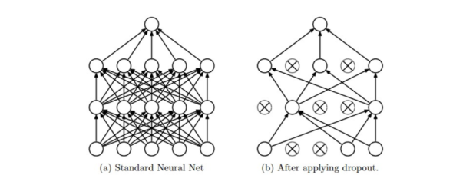
Dropout Layer
To prevent overfitting, turn off some neuron during training.

Slide 14
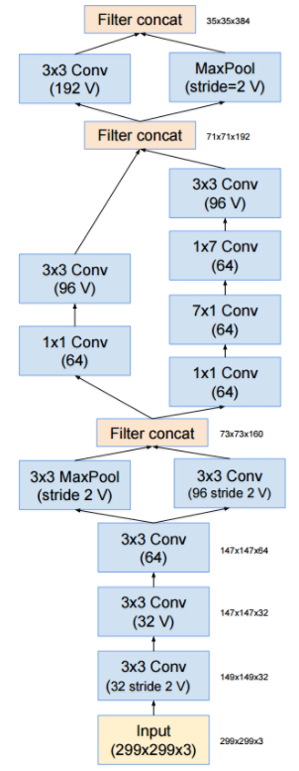
What is Inception
The deeper layer, the more accuracy.
But gradient vanishing, overfitting, too many parameter cause problems.
So google introduced the model Inception.
Stem :
not use Inception module since it makes trivial effects.

Slide 15
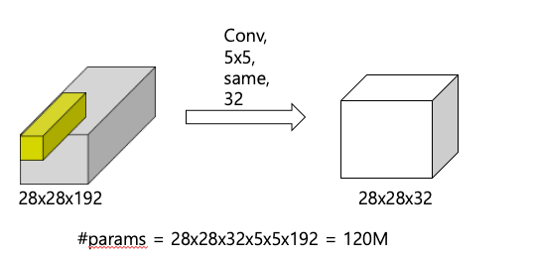
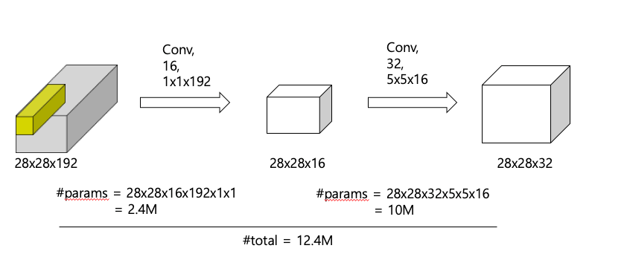
1x1 convolution
Using 1x1 convolution, we can reduce the number of dimensions with keeping original data.
The ouput channel’s number depends on filter’s number.

Slide 16
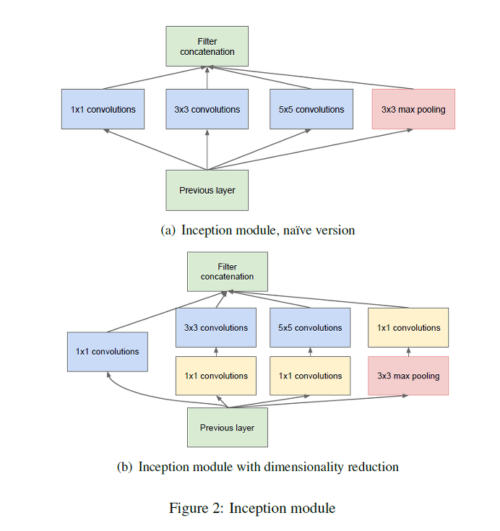
Cont’d
Inception Module
Like on your right, we can reduce computational budget by dividing the layer and concatenate afterward.
I didn’t get it actually, but they say
, Sparse network has more efficiency so they divide, but dense matrix is easy to compute with less loss of resource. So they apply the right form.

Slide 17
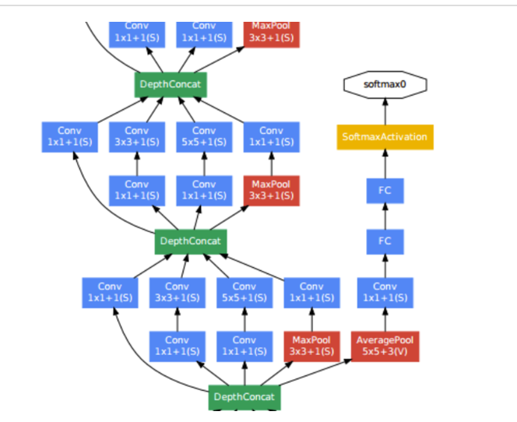
Auxiliary classifier
They use 3 softmax function total.
Two of them are used during intermediate on training so as to make back propagation well.

Slide 18
To sum up
Inception module takes an input from earlier layer and use multiple filters such as convolution and max-pooling.
Finally, the each output feature maps are concatenated.

